Slide 1
XXV Valcamonica Symposium
“Art as a Source of History”
20–26 September 2013
THE CROSS, THE SWASTIKA, THE STAR OF DAVID, AND THE EIGHT-POINTED STAR IN THE ROCK ART OF ARMENIA. THE HISTORY OF MOTIFS AND THEIR CULTURAL INFLUENCE
Prof. Vahanyan G., European Regional Academy
PhD. Vahanyan V., Yerevan State Academy of Fine Arts

Slide 2
Abstract
XXV Valcamonica Symposium “Art as a Source of History”, 20–26 September 2013
On the tree of life, the cross, the swastika, the Magen David (Shield of David, or the Star of David), the eight-pointed star written many papers. Their story is associated with paganism and continues with the spread of Judaism, Christianity and Buddhism. The tree of life, the cross, the swastika, the Shield of David had a huge impact on the consciousness of history of man, on the culture, the traditions of symbolic description of the world. However, the life philosophy and origins of the semantics of the tree of life, the cross, the swastika, the Shield of David and the eight-pointed star are less clear explained on the archetypes of the fragments of rock art of the Mountains of Ararat, moreover, are not identified the cause-effect relationships in cross-cultural influence, the universal know ledges transformation with the motifs of the cross, the swastika, the shield of David, and eight-pointed star.
The paper presents the results of a comparative study, classification and interpretation of rock art of the Araratian Mountains, which identified various transformations of the semantic motifs and knowledge of the history and intercultural influence. In paper is identified universal knowledge that is stored in the compositions of the Armenian rock arts as encyclopedia of the prototypes (archetypes) of the world visual symbolism.

Slide 3
The history of of the universal symbols and their cultural influence
XXV Valcamonica Symposium “Art as a Source of History”, 20–26 September 2013
A comparative study of the motives of the symbols, the visual archetypes of the cognitive graphics and ornamentation, the main motives of the world's religions and mythologies, scientific concepts and ideas of E. Anati and (Valcamonica Symposiums papers) in the context of linguistic description, allowed the authors to sum up the 30-years study and to present them. First, the world rock art - is a cognitive protolanguage ​​of ancient civilizations. This cultural phenomenon distinguishes the thinking man from the wild, humanoid, less developed culturally. The carriers of this protolanguage we call human and his preart of communication. Thus, the rock art - it's mother tongue, which describes the prehistory of the history of civilization and at the same time, the prehistory of a cognitive language (stone encyclopedia of ideas, thinking, feelings, emotions, human values).
It is in this duality is a more complete explanation of the phenomenon of world rock art and the understanding of its essence documented for posterity cultural prehistory of humanity. Through the knowledge of the prelanguage, we may be able to better predict the future of humanity in the paradigm of universal cultural values. Unlike other cultural artefacts and archaeological sites are given a visual mother tongue and created with the help of the legacy of rock art-minded person deliberately shaped this wealth to preserve and transmit to future generations, we were taught to "rock voice" and were able to master the ideas, thoughts, values ​​and knowledge that they possess. Thanks to them.

Slide 4
The visual protoalphabet of the human prehistory
XXV Valcamonica Symposium “Art as a Source of History”, 20–26 September 2013
Of the tens of thousands of rock paintings of the world we detected and identified universal, invariant, typical, most informative visual elements of the Protoalphabet of the archaic civilizations of the world, whose ancestors still live. Among them, the cross - the most symmetrical image. His multi-variant, flexibility and dynamism, the emergence of cognition and the imagination of modern man and are characterized by a unique range of its semantic description (cross serves to indicate the plant and animal worlds, the human and the cosmos, Heaven and Earth, the trees of life and of knowledge good and evil). It depicts the newborn human, and God Father and Son. Winged cross alive, living image, wingless - lifeless, dead. Direct cross symbolizes the male principle, oblique - feminine. The union of male and female is in the form of eight-pointed star, the eight-pointed cross or eight-socket, which, depending on the context, are symbols of love, fertility, the divine nature of Venus and the Virgin Mary.

Slide 5
XXV Valcamonica Symposium “Art as a Source of History”, 20–26 September 2013
Endless circle or circle represents an integer enclosed space that stands out from the chaos of the Creator-Father-God, and at the same time is "invisible" image of the Creator-God-Father. In the form of the circle described by the Earth and the heavens, and the universe. The eight-pointed cross in a circle transforms the idea of ​​the Trinity–God-Father in heaven (Space), God the Son and the Mother Goddess (The Virgin), or what we call Family.
Triangle - another element of the Protoalphabet, which depict the hearth, hill, house, family, clan and tribe. Heavenly different focus - a triangle, home the top down and the Earth's center - a triangle pointing up the house. The triangular shape represents a step-pyramid or Calvary. Mountain range, consisting of a set of triangles along a straight line or a circle - this space, the territory on which they live or the unification of related tribes and nations. Two triangles superimposed on each other - this union, unification of the two centers, homes, families, clans, tribes.

Slide 6
XXV Valcamonica Symposium “Art as a Source of History”, 20–26 September 2013
Rectangle, square or octagonal outlet in the diamond shape surrounded by a pair of lions, eagles and swastikas - is a comprehensive, well-established hearth, solid house that represents the union or joining of many peoples, nations, under the auspices of the gods of heaven and earth. Two squares superimposed on each other, it is a strong union of heaven and earth houses, many unification triangles, families, clans and tribes. With the help of the square were a group of kindred tribes of hunters, ranchers and early farmers.
Swastika - is also one of the main characters of movement, development, the course of history. Dextrorotatory swastika shows a positive development, the rule of personifying the forces of good, light and life. Levorotatory swastika symbolizes the rule of the evil forces of darkness, chaos and death. Two swastikas (dextrorotatory and levorotatory), superimposed on each other, represent a square with a cross. Swastika in front of the animal (a snake or a bull) illustrates the history of the struggle between good and evil, the struggle of man against the volcanic eruptions and earthquakes in a struggle with the celestial bull, a dragon or a snake, symbolically depicting the deadly lava and fire, toxic smoke.
One of the famous characters of the Protoalphabet – Shield (Star) of David, or “Paterazma khach" (Armenian Cross of War), which served as a talisman, a symbol of the patronage of the God-Father. Depicted as a circle or a square with eight-pointed cross or swastika, symbolizing the victory of the forces of good, light, order over the forces of evil, chaos, darkness. Image of a dragon or a bull against the swastika symbolizes a victory over the enemy (of earthquakes, volcanic eruptions and other natural disasters, etc.).

Slide 7
XXV Valcamonica Symposium “Art as a Source of History”, 20–26 September 2013
The eight-pointed star has transformed over thousands of years in the image of a modern menorah. In fact, the archetype of the menorah is the eight-pointed star, based on one of its eight rays as the ground that resembles a stepped mountain (Calvary or Pyramid). The essence of the menorah (menorah) - a tribute to the memory of the loss (death) of the founder of the archaic civilization to mankind in the first son of the God-Father, whose name was Vahagn the son of Van and An (God-Mother) - the first teachers.
The image of a man with male genitalia - an illustration of a union of Heaven and Earth. Here lies the clue, perhaps, emphasizes the primary role of humanity. Judging by the rock paintings, the mission of humanities in sustainability communications (union) of one Family in the form of Heavenly and Earthly forces (harmonizing the relations of Heaven and Earth). Image of a woman sitting on his haunches with a cradle and a small cross (a unique story of the Armenian rock paintings) is transformed into images of Our Lady, and God-Father - the large winged cross and implements as an archetype in the visual motifs of Christianity in the modern fine and decorative arts. Image motive struggle with Heavenly Bull Hero of rock art is transformed into a universal theme of chivalry, courage, fight or battle hero, warrior on horseback (the prototype of George the Victorious) with a spear, killing a snake (or dragon).

Slide 8
XXV Valcamonica Symposium “Art as a Source of History”, 20–26 September 2013
The eight-pointed star is found both in Armenian rock paintings, as well as in the pre-Christian symbolism (in the period of paganism), and the art of the Christian Middle Ages. It is used in Armenian «vishapakars» (dragon stones) and cross-stones, in miniature, in carpet weaving, in the ornamentation, in architecture. The eight-pointed star, as an archaic motif of union and unification, has entered into the modern symbols of the coat of arms and the flag of the United Kingdom.The swastika was a symbol of Buddhism and a symbol of Nazi Europe, in particular Germany Flag. We see image of the triangle (step pyramid) and the Shield of David on the one-dollar bill, which is a testament to the stability of the cultural traditions of the Protoalphabet.
The name of the one-dollar bill (one dollar) is translated into Armenian as ONE (1; pron.: wʌn) is a number, a numeral, and the name of the glyph representing that number) - "Van", which is a linguistic symbol of the Whole, the First, the Creator, Hero, Founder (in Armenian Van is the name of Kingdom, the name of the lakes Van and Sevan (black Van), “avan” village, “avand” heritage). Father created in the Mountains of Ararat a first human by the name of Vahagn (as symbol of Victory and Culture). Fearless dragonfighter Vahagn - the Son of God defeated a mighty dragon and buried him on Mount Nemrud near lake Van. With roots of Van is related to many Indo-European gods, including the gods of German-Scandinavian tribes and peoples. About Van there are many legends of different peoples of the world. Vahagn was identified with the Greek Heracles.

Slide 9
XXV Valcamonica Symposium “Art as a Source of History”, 20–26 September 2013
The priests of Vahévahian temple, who claimed Vahagn as their own ancestor, placed a statue of the Greek hero in their sanctuary. In the Armenian translation of the Bible, "Heracles, worshipped at Tyr" is renamed "Vahagn". The love story of Vahagn (Direct Cross in Armenian rock art) and his bride Astghik (Oblique cross as archetype of star and Venus in the Armenian rock art), according to professor N. Marr, was the prototype of the more well-known to Europeans love story of Tristan and Isolde. According to the professor V.V. Ivanov Armenian and Greek mythology have a lot in common. Moreover, once their ancestors are united by a single language framework that serves to generate not only the Indo-European family of languages. According to the “History of Armenia” by M. Khorenatsi (Armenian historian of IVc.) one of the 12 tribes that have played an important role in the formation of the Jewish nation and culture, were from the Armenian Plateau. They considered it their home space (Earth and Sky) near Lake Van. Astghik had been the wife of Vahagn. Her name is the diminutive of Armenian astġ, meaning "star", which through Latin and Italian stella and astro, French astre, Spanish astro, German stern, English star and Semitic Ishtar.

Slide 10
XXV Valcamonica Symposium “Art as a Source of History”, 20–26 September 2013
The figure below shows the fragments of the universal characters of Protoalphabet, which are allocated by us from the study of the Mountains of Ararat. It should be noted that the phenomenon of rock art culture of the Araratian civilization as creator for all known forms of early writing systems – pictograms, ideogramms, hieroglyphic, cuneiform and the alphabet. Until now, the descendants of the Araratian civilization remain faithful to the cross, swastika, star of David, love (eight-pointed star), the moon and the sun, and the eye brows, the family hearth, the triangle, the triangle house (“glghatun” in Armenian - mountains of Ararat), the Earth and the Heavenly Mother, God-Van-Vahagn as the life-giving beginning.
All these signs are more valuable in unity. The various peoples of the world appropriated some of them. They are now used separately, in isolation, is not presenting, unfortunately, their main idea, all of the properties, their essence in a relationship in a one system of the values. World rock art, including Armenian, want to say “please, open yours eyes on the amazingly beautiful, rich, unknown world of rock "speech", music and dancing. So the rock art is a visual archaic “speech” and Protolanguage of communication and study of the cultural prehistory of humanity. The study of the unique monuments of prehistoric Armenia, "višap" vishaps (Armenian višap serpent, dragon) or "dragon stones" with the rock arts, spread in many provinces of historical Armenia – Gegharkunik, Aragatsotn, Javakhk, Tayk. Armenian rock art in the context of the identified linguistic interpretations of elements of the Protoalphabet, universal cultural characters shows that they are preserved and are found not only in paintings, but is now widely used in modern culture - cross-stones, miniature, carpet weaving, ornaments, arts and crafts, architecture, painting.

Slide 11
References
XXV Valcamonica Symposium “Art as a Source of History”, 20–26 September 2013
Vahanyan G., Vahanyan V. Rock Art as a Paradigm of Communication and Visual Arts in the Past and Future. XXIV Valcamonica Symposium "Art and Communication in Pre-literate societies", 13-18 July 2011, Valcamonica, Italy.
Vahanyan G. Volcanic eruptions from Mountains of Ararat till Alps, Indo-European myths, Rock art and iconography. Convegno internazionale, L’ARTE RUPESTRE DELLE ALPI, 21-24 Ottobre 2010. Capo di Ponte - Valcamonica, Italy.
Vahanyan V., Vahanyan G. Armenian Pleistocene Rock Art as Origin of the Universal Visual Motifs of the Indo-European Myths. IFRAO Congress, 6-11 September 2010 Symposium. “Signs, symbols, myth, ideology”. Ariège - Pyrénées, France.
Vahanyan V., Vahanyan G. Intercultural relations between Old Europe and Old Armenia. XXIII Valcamonica Symposium "Making history of prehistory, the role of rock art", 28 October - 2 November 2009, Valcamonica, Italy.
Vahanyan V. The epistemology and the linguistic-historical comparative analysis of the Armenian and world rock art and visual artifacts. XXIII Valcamonica Symposium "Making history of prehistory, the role of rock art", 28 October - 2 November 2009, Valcamonica, Italy.
Vahanyan G. Rock Art in the Frame of the Cultural Heritage of Humankind. XXII Valcamonica Symposium, Darfo Boario Terme (BS), 18 - 24 May, 2007, Valcamonica, Italy.
Vahanyan G., Vahanyan V. Stone annals of Civilization. Yerevan, Nzhar. Monograph, 2006, Armenia.
Vahanyan G., Bleyan V., Qocharyan L., Vahanyan V. Rock Аrts of Armenian High­land. Тhe International Conference “World of Rock Art”, 2005. Institute of Archaeology of the Russian Academy of Sciences, Moscow, Russia.
Vahanyan G., Stepanyan A. Searches for Protocivilization (Rock Arts, the Processes of Learning and Thinking). Тhe International conference “World of Rock Art”, 2005. Institute of Archaeology of the Russian Academy of Sciences, Moscow, Russia.
Vahanyan G., Stepanyan A. Prehistoric art in Armenia: new discoveries, new interpretations and new methods of research. XXI Valcamonica Symposium "Prehistoric and Tribal Art: New Discoveries, New Interpretations, New Research Methods", 8-14 September, 2004. Darfo Boario Terme (BS), Italy.
Vahanyan G., Petrosyan S. Karedaran - The Database of Armenian Rock Art. (Tracce #12, Online Bulletin by Footsteps of Man), 1991, Italy.

Slide 12
Figures
XXV Valcamonica Symposium “Art as a Source of History”, 20–26 September 2013
Fig. 1. Armenian Rock art: the Earth as the global life-giving - Cross (a), direct and oblique crosses as a union of male (with male sign) and female (b) and winged cross (c).
Fig. 2. Armenian Rock art: a cross and newborn (a, b). The Cross and the eight-pointed star and World Tire (c), Heavenly Thunder (d).
Fig. 3. Armenian Rock art: fight the forces of good as swastika (a) with the forces of evil (celestial bull) and the national flag of Nazi Germany (b). The celestial bird fighting with snake. (c). Swastika on the polished ceramics (d), Shengavit, Armenia (5-4 century BC). Swastika and the fight scene with the celestial bird fighting with fish (e), an artifact from Samarra (Iraq), 4th century BC, Berlin.
Fig. 4. Armenian Rock art: "The Christening in the cradle," the archetype of Madonna (a). Venus-Aphrodite holding an infant and Luna-Selene from Roman-era relief (b). Madonna Litta (Leonardo da Vinci), St. Petersburg, State Hermitage (c).
Fig. 5. The motive of the tree of life as prototype of menorah, Armenian rock art (a). The stone “tree of life”, the Museum "Erebuni" Armenia (b). The tree of life with sun and plant elements - similar eight-pointed cross, Urartu, 9-7 BC (c). Coin (Matityahu) Antigonus II the last king of Judah (d) from the Hasmonean dynasty (37 year BC).
Fig. 6. Solar cart. Armenian rock art (a). Solvognen, XVIII - XVII centuries BC, gold. The National Museum of Denmark, Copenhagen (b).
Fig. 7. Divine hero as а male symbol of a unit of Heavenly and Earthly worlds, Armenian rock art (a). David by Michelangelo (b).
Fig. 8. Armenian rock art: the transformation of the hero motif struggle with the celestial serpent, dragon, Armenian Rock art (b). 7th century depiction of Odin on a Vendel helmet plate, Uppland (c).
Fig. 9. Eight-pointed crosses with a stepped base on cross-stones of Garni and Geghard Armenia (a). The flag of Great Britain (b).
Fig. 10. Fragments of the Armenian stone Encyclopedia of symbols, Buzhakan.
Fig. 11. The Geghama Mountains (Armenia)
Fig. 12. The Rock Art of the Geghama Mountains
Fig. 13. Pokar volcano (Armenia)
Fig. 14. The Ughtasar Volcano with many rock paintings (Armenia)
Fig. 15-16. The Ukhtasar Volcano Rock Art, Armenia
Fig. 17. Ajdahak Volcano with many rock paintings that have been carved before the eruption of the volcano (Armenia)
Fig. 18-28. The Ajdahak Volcano Rock Art, Armenia

Slide 13
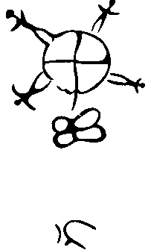
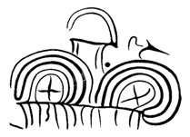
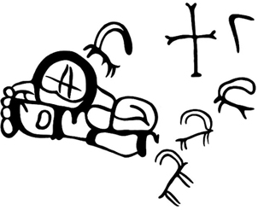



Fig. 1. Armenian Rock Art: the Earth as the global life-giving - Cross (a), direct and oblique crosses as a union of male (with male sign) and female (b) and winged cross (c)
XXV Valcamonica Symposium “Art as a Source of History”, 20–26 September 2013
a
a
b
c

Slide 14
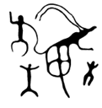
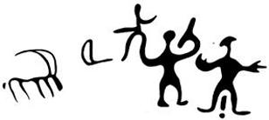
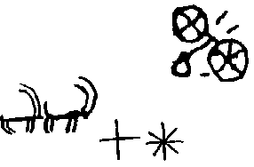
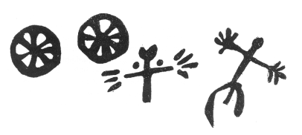
Fig. 2. Armenian Rock Art: a cross and newborn (a, b). The Cross and the eight-pointed star and World Tire (c), Heavenly Thunder (d)
XXV Valcamonica Symposium “Art as a Source of History”, 20–26 September 2013
a
a
b
c
d

Slide 15
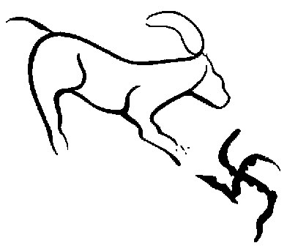

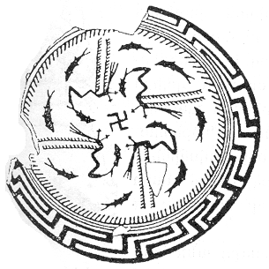
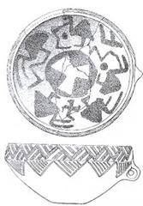



Fig. 3. Armenian Rock Art: fight the forces of good as swastika (a) with the forces of evil (celestial bull) and the national flag of Nazi Germany (b). The celestial bird fighting with snake. (c). Swastika on the polished ceramics (d), Shengavit, Armenia (5-4 century BC). Swastika and the fight scene with the celestial bird fighting with fish (e), an artifact from Samarra (Iraq), 4th century BC, Berlin
XXV Valcamonica Symposium “Art as a Source of History”, 20–26 September 2013
a
a
b
c
d
e

Slide 16
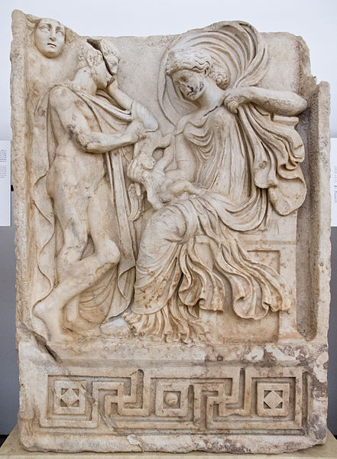
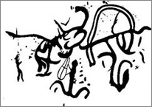
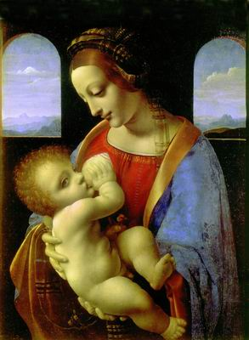
Fig. 4. Armenian Rock Art: "The Christening in the cradle," the archetype of Madonna (a). Venus-Aphrodite holding an infant and Luna-Selene from Roman-era relief (b). Madonna Litta (Leonardo da Vinci), St. Petersburg, State Hermitage (c)
XXV Valcamonica Symposium “Art as a Source of History”, 20–26 September 2013
a
b
a
b
c

Slide 17





Fig. 5. The motive of the tree of life as prototype of menorah, Armenian rock art (a). The stone “tree of life”, the Museum "Erebuni" Armenia (b). The tree of life with sun and plant elements - similar eight-pointed cross, Urartu, 9-7 BC (c). Showing the holy tree, which also appears on the felt covers of the horses in the Pazyryk rug (d). Coin (Matityahu) Antigonus II the last king of Judah from the Hasmonean dynasty (37 year BC) (e).
XXV Valcamonica Symposium “Art as a Source of History”, 20–26 September 2013
a
a
a
b
c
b
a
b
c
d
e

Slide 18
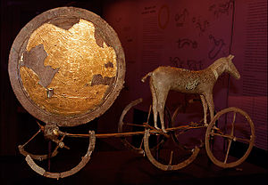
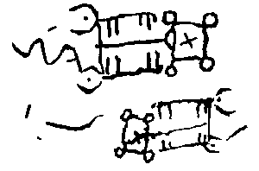
Fig. 6. Solar cart in Armenian Rock Art (a).
Solvognen, XVIII - XVII centuries BC, gold.
The National Museum of Denmark, Copenhagen (b)
XXV Valcamonica Symposium “Art as a Source of History”, 20–26 September 2013
a
a
a
b
c
a
b
b

Slide 19
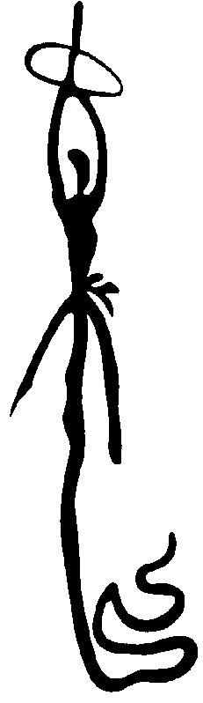
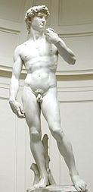

Fig. 7. Divine hero as а male symbol of a unit of Heavenly and Earthly worlds, Armenian Rock Art (a). David by Michelangelo (b)
XXV Valcamonica Symposium “Art as a Source of History”, 20–26 September 2013
a
a
a
b
c
b
a
b

Slide 20
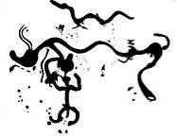
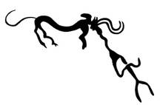
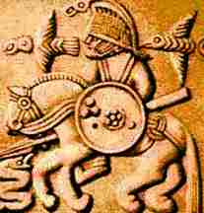
Fig. 8. Armenian Rock Art: the transformation of the hero motif struggle with the celestial serpent, dragon, Armenian Rock Art (b).
7th century depiction of Odin on a Vendel helmet plate,
Uppland, Sweden (c)
XXV Valcamonica Symposium “Art as a Source of History”, 20–26 September 2013
a
a
a
b
c
b
a
b
c

Slide 21
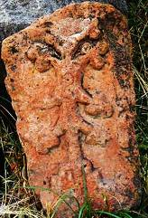
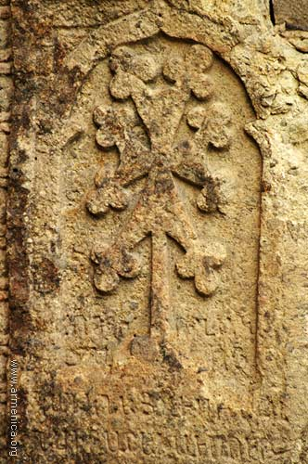


Fig. 9. Eight-pointed crosses with a stepped base on cross-stones of Garni and Geghard Armenia (a). The flag of Great Britain (b)
XXV Valcamonica Symposium “Art as a Source of History”, 20–26 September 2013
a
a
a
b
c
b
a
b

Slide 22
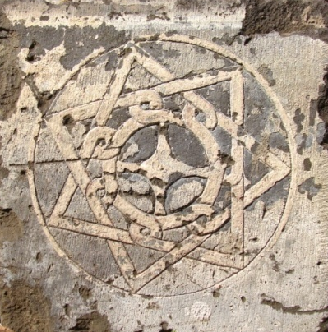
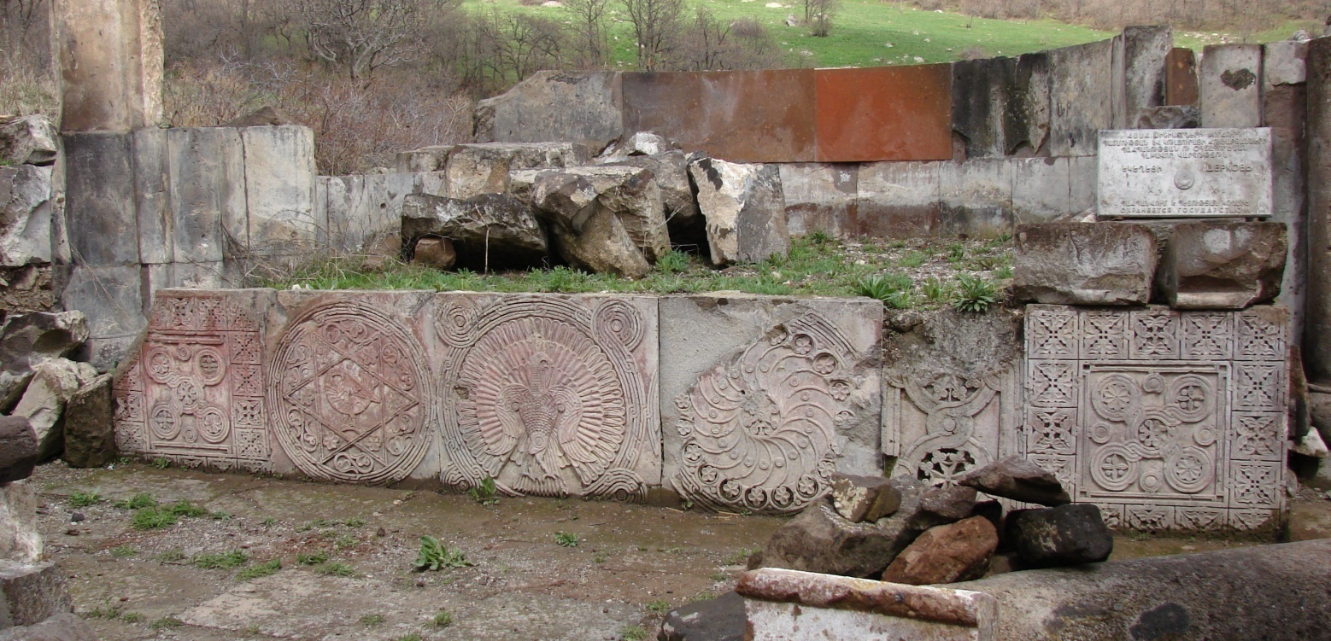
Fig. 10. Fragments of the Armenian stone Encyclopedia of symbols,
Buzhakan, Armenia
XXV Valcamonica Symposium “Art as a Source of History”, 20–26 September 2013
c
b
b

Slide 23
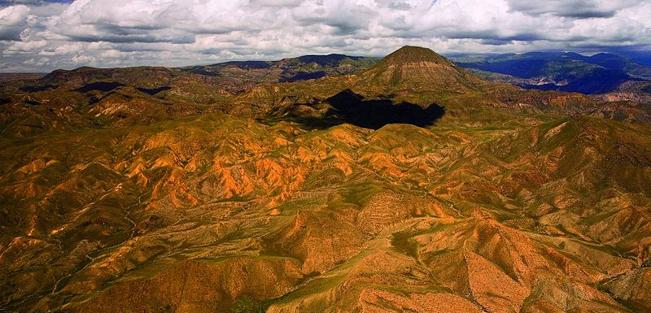
Fig. 11. The Geghama Mountains (Armenia)
XXV Valcamonica Symposium “Art as a Source of History”, 20–26 September 2013
a
a
a
b
c
b
a
b

Slide 24
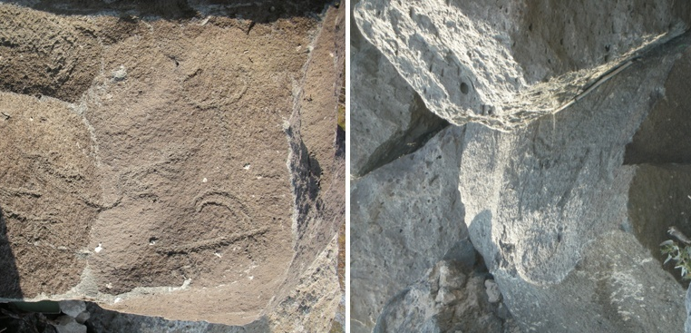
Fig. 12. The Rock Arts of the Geghama Mountains, Photo V. Vahanyan
XXV Valcamonica Symposium “Art as a Source of History”, 20–26 September 2013
a
a
a
b
c
b
a
b

Slide 25
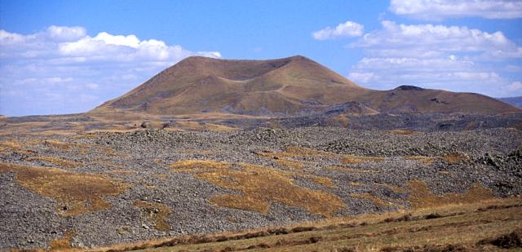
Fig. 13. Pokar Volcano (Armenia)
XXV Valcamonica Symposium “Art as a Source of History”, 20–26 September 2013
a
a
a
b
c
b
a
b

Slide 26
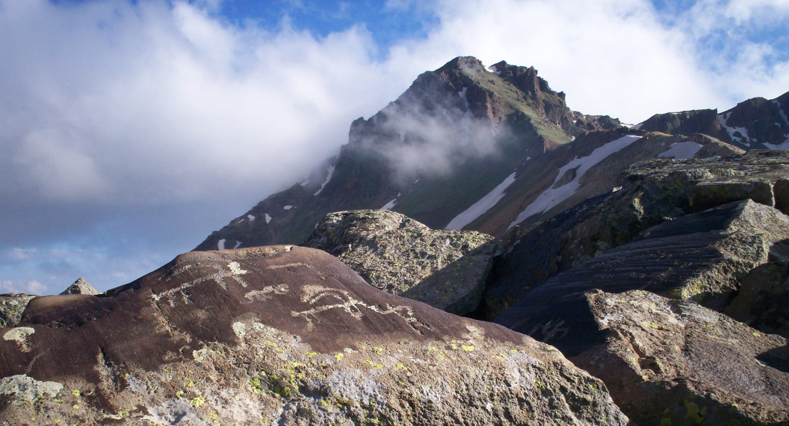
XXV Valcamonica Symposium “Art as a Source of History”, 20–26 September 2013
a
a
a
b
c
b
a
b
Fig. 14. The Ughtasar Volcano with many Rock Arts (Armenia)

Slide 27
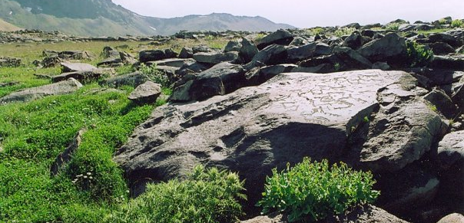
Fig. 15. The Ukhtasar Volcano Rock Arts, Armenia, Photo T. Walkling
XXV Valcamonica Symposium “Art as a Source of History”, 20–26 September 2013
a
a
a
b
c
b
a
b

Slide 28
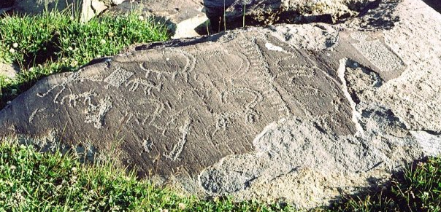
Fig. 16. The Ukhtasar Volcano Rock Arts, Armenia, Photo T. Walkling
XXV Valcamonica Symposium “Art as a Source of History”, 20–26 September 2013
a
a
a
b
c
b
a
b

Slide 29
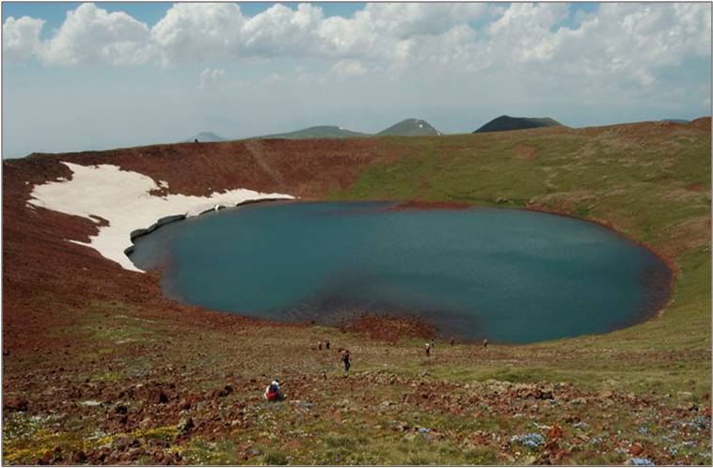
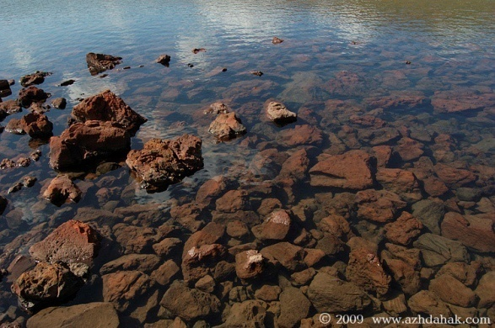
Fig. 17. Ajdahak volcano with many rock arts that have been carved before the eruption of the volcano (Armenia) http://www.azhdahak.com/
XXV Valcamonica Symposium “Art as a Source of History”, 20–26 September 2013
a
a
a
b
c
b
a
b

Slide 30
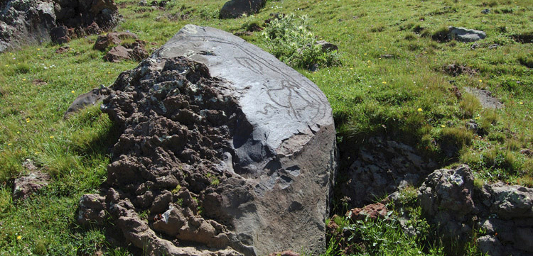
Fig. 18. The Ajdahak Volcano Rock Arts, Armenia http://www.azhdahak.com/
XXV Valcamonica Symposium “Art as a Source of History”, 20–26 September 2013
a
a
a
b
c
b
a
b

Slide 31
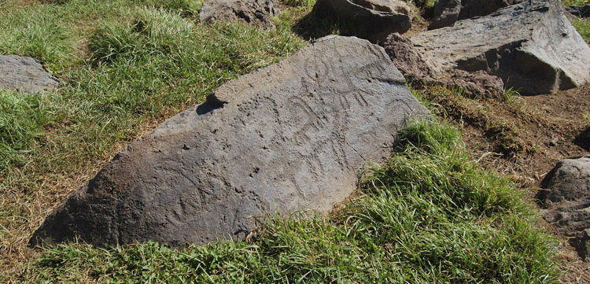
XXV Valcamonica Symposium “Art as a Source of History”, 20–26 September 2013
a
a
a
b
c
b
a
b
Fig. 19. The Ajdahak Volcano Rock Arts,
http://www.azhdahak.com/

Slide 32
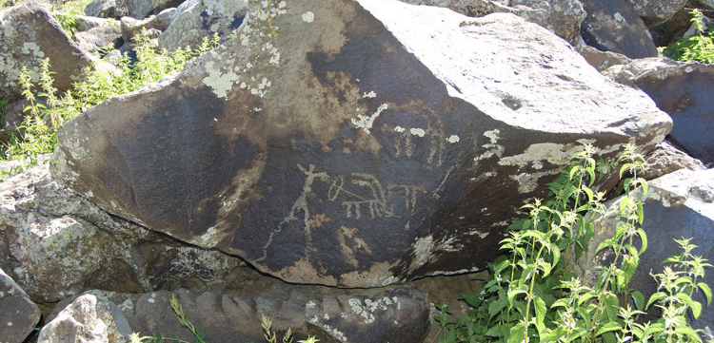
XXV Valcamonica Symposium “Art as a Source of History”, 20–26 September 2013
a
a
a
b
c
b
a
b
Fig. 20. The Ajdahak Volcano Rock Arts, Armenia
http://www.azhdahak.com/

Slide 33
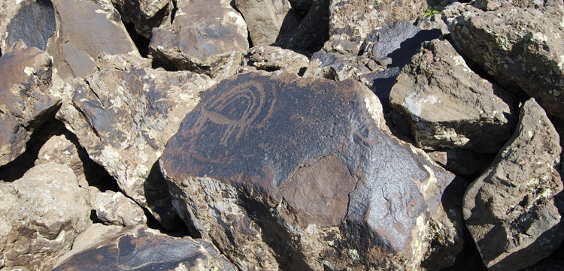
XXV Valcamonica Symposium “Art as a Source of History”, 20–26 September 2013
a
a
a
b
c
b
a
b
Fig. 21. The Ajdahak Volcano Rock Arts, Armenia
http://www.azhdahak.com/

Slide 34
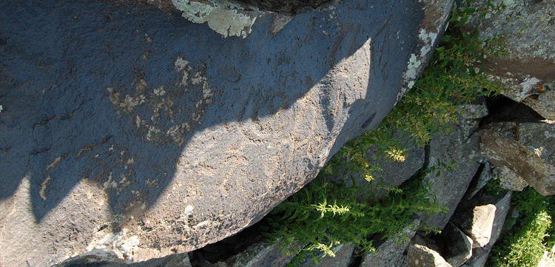
XXV Valcamonica Symposium “Art as a Source of History”, 20–26 September 2013
a
a
a
b
c
b
a
b
Fig. 22. The Ajdahak Volcano Rock Arts, Armenia
http://www.azhdahak.com/

Slide 35
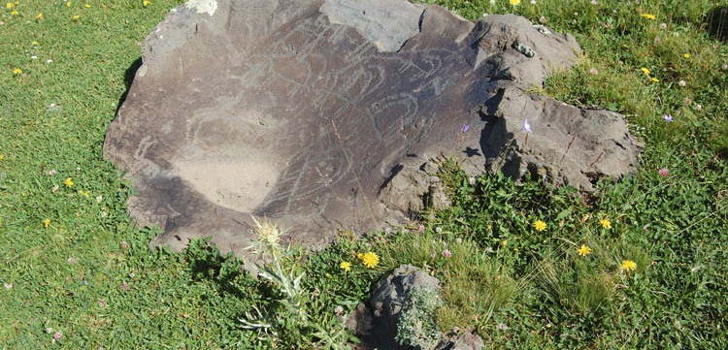
XXV Valcamonica Symposium “Art as a Source of History”, 20–26 September 2013
a
a
a
b
c
b
a
b
Fig. 23. The Ajdahak Volcano Rock Arts, Armenia
http://www.azhdahak.com/

Slide 36
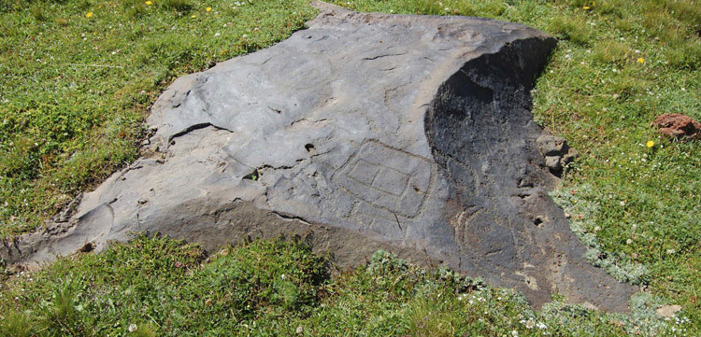
XXV Valcamonica Symposium “Art as a Source of History”, 20–26 September 2013
a
a
a
b
c
b
a
b
Fig. 24. The Ajdahak Volcano Rock Arts, Armenia
http://www.azhdahak.com/

Slide 37
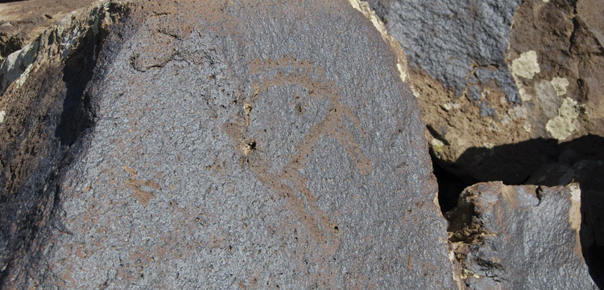
XXV Valcamonica Symposium “Art as a Source of History”, 20–26 September 2013
a
a
a
b
c
b
a
b
Fig. 25. The Ajdahak Volcano Rock Arts, Armenia
http://www.azhdahak.com/

Slide 38
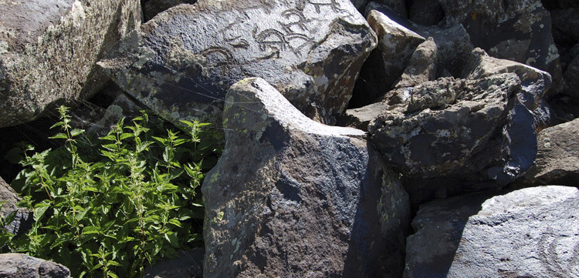
XXV Valcamonica Symposium “Art as a Source of History”, 20–26 September 2013
a
a
a
b
c
b
a
b
Fig. 26. The Ajdahak Volcano Rock Arts, Armenia
http://www.azhdahak.com/

Slide 39
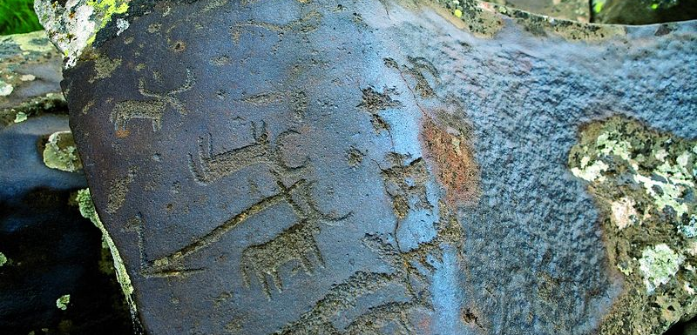
XXV Valcamonica Symposium “Art as a Source of History”, 20–26 September 2013
a
a
a
b
c
b
a
b
Fig. 27. The Ajdahak Volcano Rock Arts, Armenia
http://www.azhdahak.com/

Slide 40
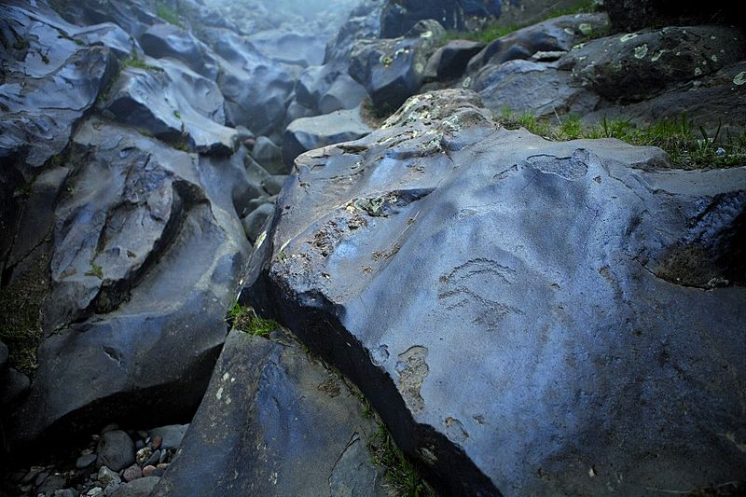
XXV Valcamonica Symposium “Art as a Source of History”, 20–26 September 2013
a
a
a
b
c
b
a
b
Fig. 28. The Ajdahak Volcano Rock Arts, Armenia
http://www.azhdahak.com/

Slide 41
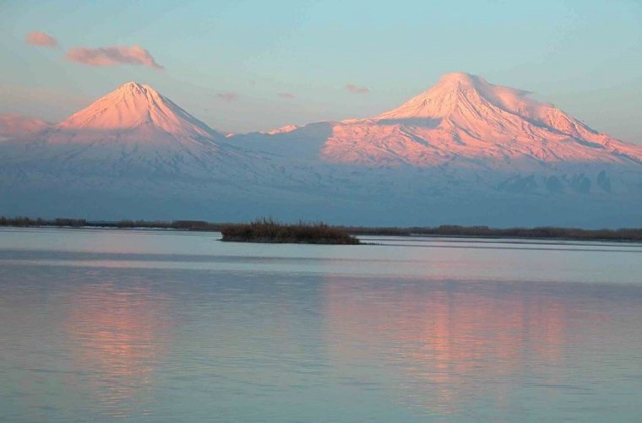
Araratian Mountains (PART II)

