Slide 1
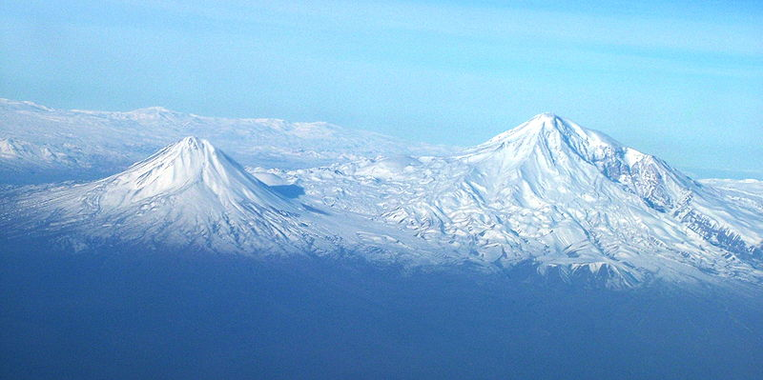
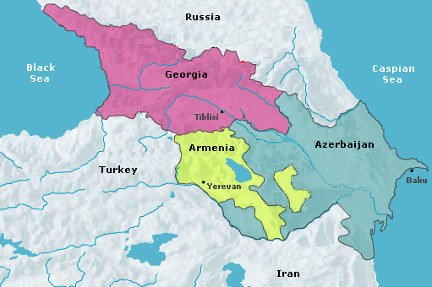
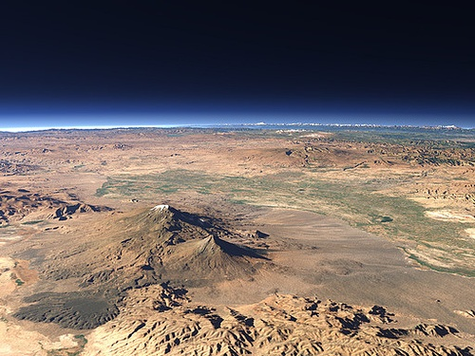

Araratian Mountains
Part 2

Slide 2
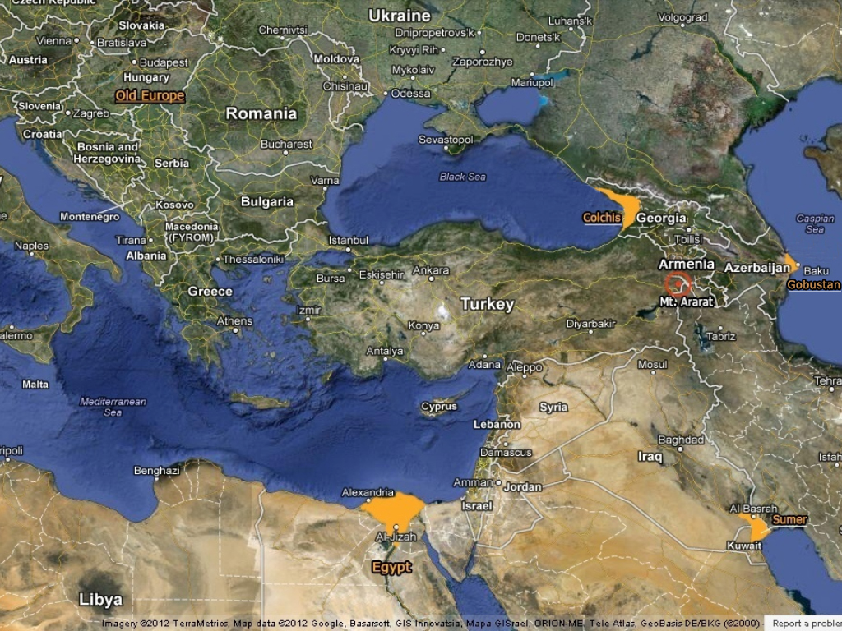
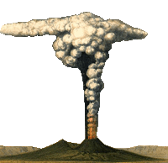


The Area of Dissemination of Araratian Rock Arts

Slide 3

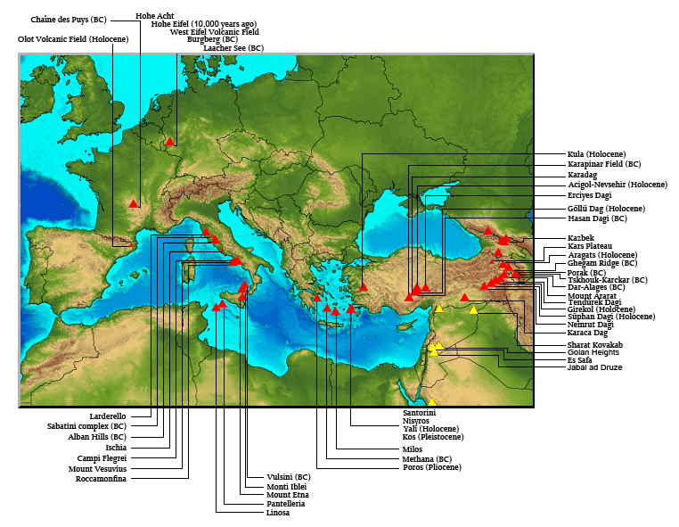
Araratian Mountains
From Armenian to the Greco-Roman mythology and volcanic eruptions. Large red triangles show volcanoes with known or inferred Holocene eruptions; small red triangles mark volcanoes with possible, but uncertain Holocene eruptions or Pleistocene volcanoes with major thermal activity. Yellow triangles distinguish volcanoes of other regions http://www.volcano.si.edu/world/region.cfm?rnum=01

Slide 4
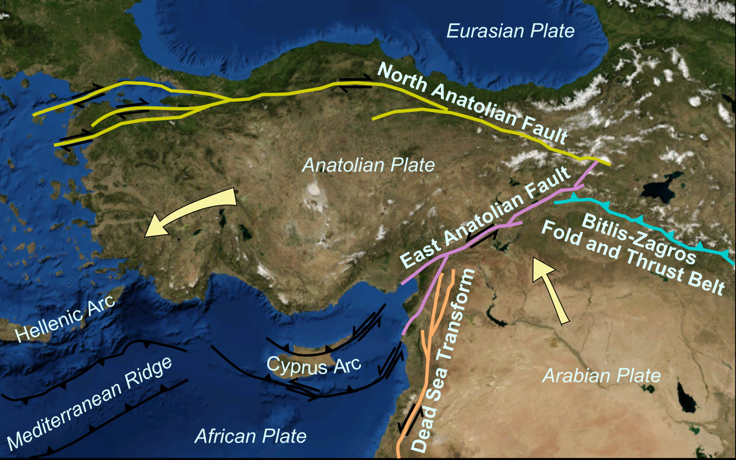
Araratian Mountains
North Anatolian Fault and East Anatolian Fault, Bitlis-Zagros Fold and Thrust Belt

Slide 5
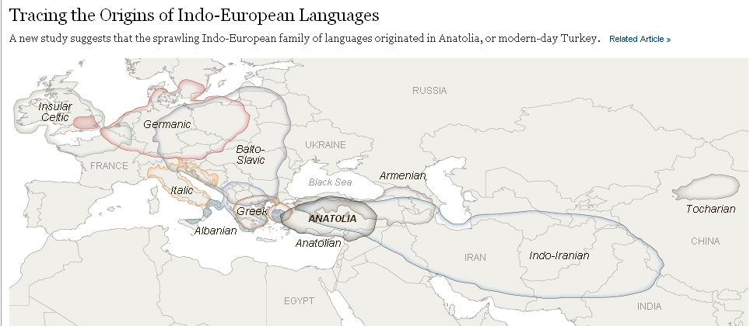
Araratian Mountains
Tracing the Origins of Indo-European Languages.

Slide 6
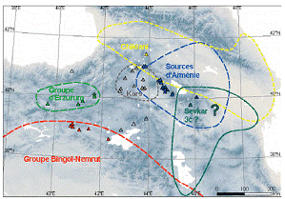
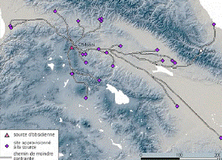
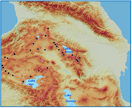
Araratian Mountains
А
Б
В
А - The figures show the scheme of supply routes of obsidian, including obsidian mining areas and areas on the periphery, Б - Scheme of supply routes of obsidian,
В - Location of the obsidian sources in Araratian Mountains.
(by C. Chataigner, O. Barge)

Slide 7
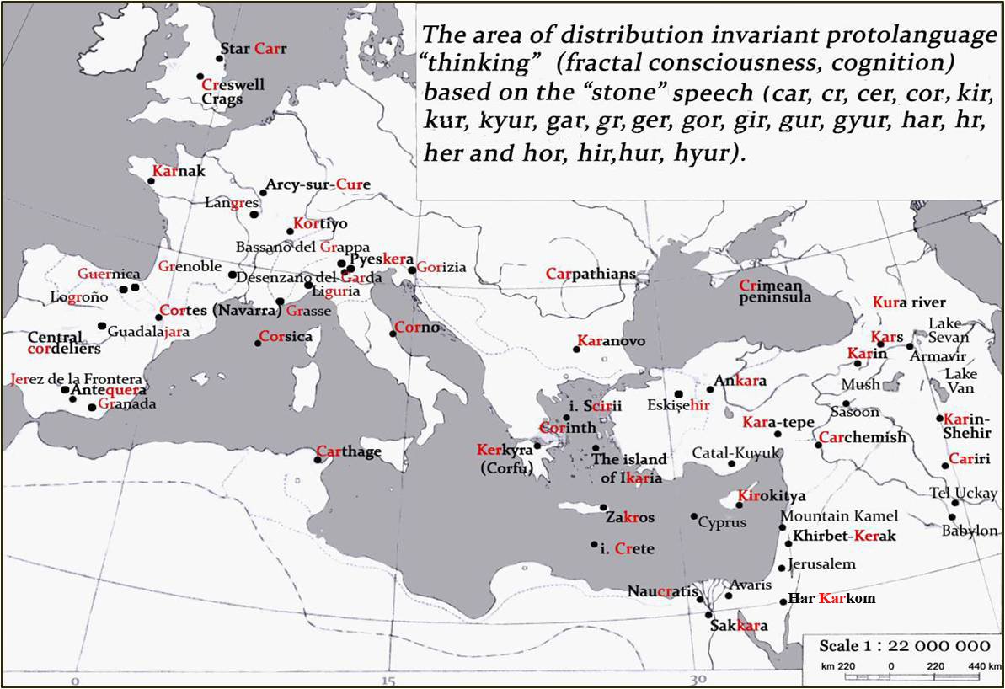
Araratian Mountains
The area of distribution invariant protolanguage “thinking” (fractal consciousness, cognition) based on the “stone” speech (car, cr, cer, cor, kir, kur, kyur, gar, gr, ger, gor, gir, gur, guyr, har, hr, her and hor, hir, hur, hyur) (by G. Vahanyan).

Slide 8
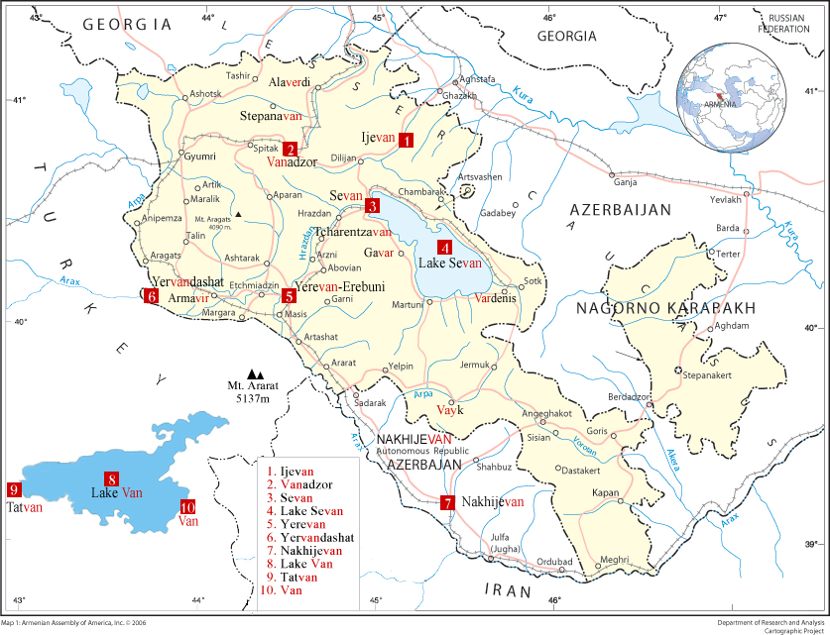
Araratian Mountains
The distribution map of the lakes, towns and cities with names from the root of the "Van“ in Armenia.

Slide 9
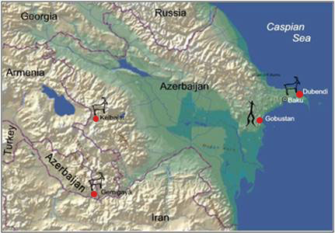
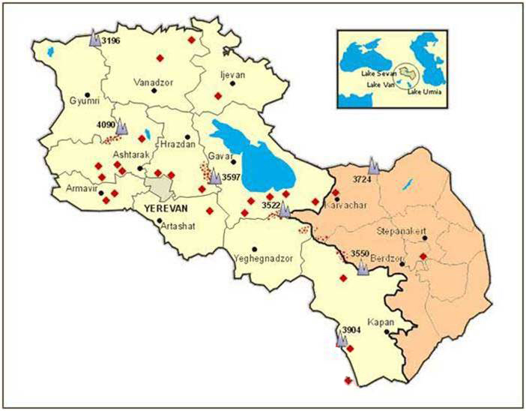
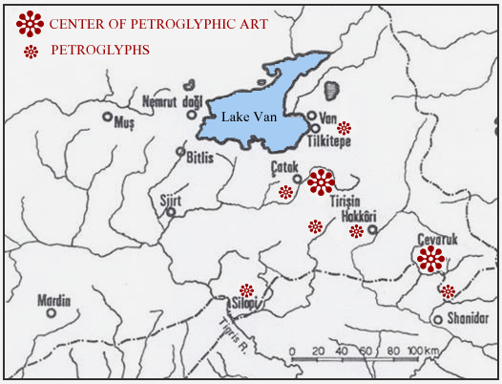
Araratian Mountains
The area of dissemination of Araratian Rock Arts
(by M. Farajova).
The area of dissemination of Araratian Rock Arts
(by K. Tochatyan).
Area of dissemination of petroglyphs of South – Eastern Anatolia (Turkey), near Van. Map from Bolletino dell CCSP, Vol. Quatro, Capo di Ponte 1972
(by prof. E. Anati).

Slide 10
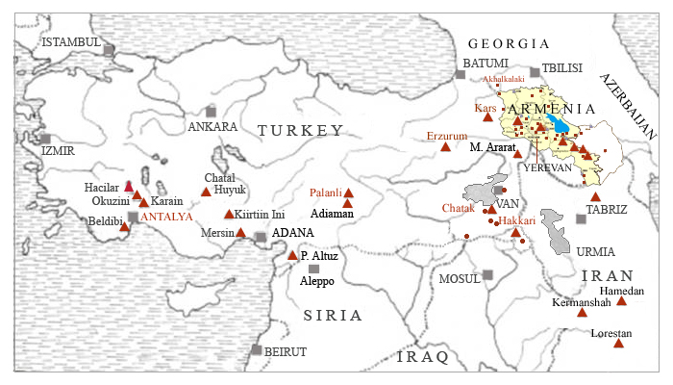
Araratian Mountains
The updated map of the spread of rock arts in the territory of historical Armenia, regions of Anatolia and Iran (by "Prehistoric Art of Anatolia” of prof. E. Anati . CCDSP, Volume Quatro, Capo Di Ponte, Brescia, Italy, 1972)

Slide 11
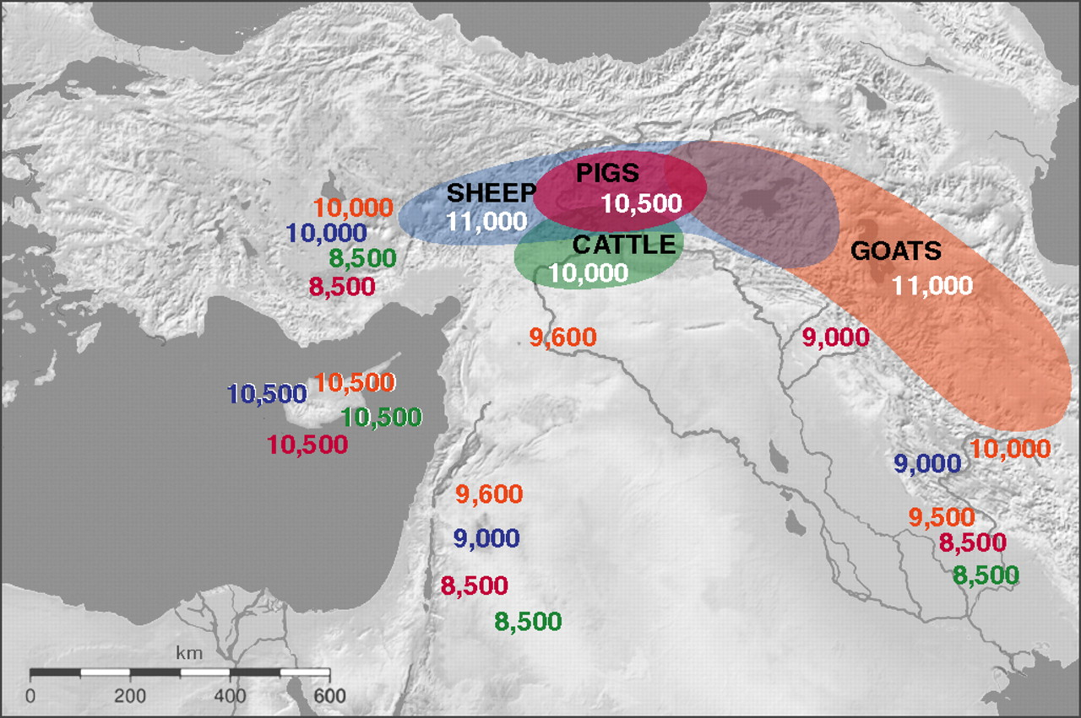
Araratian Mountains
The origin and dispersal of species of livestock.

Slide 12
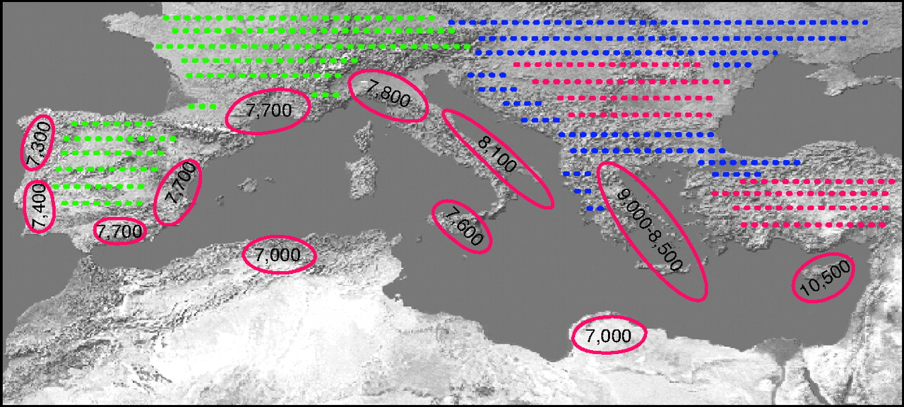
Araratian Mountains
The integrated model of agricultural areas Neolithic culture in the Mediterranean basin.

Slide 13
List of maps
From Armenian to the Greco-Roman mythology and volcanic eruptions.
North Anatolian Fault and East Anatolian Fault, Bitlis-Zagros Fold and Thrust Belt.
Tracing the Origins of Indo-European Languages.
The figures show the scheme of supply routes of obsidian, including obsidian mining areas and areas on the periphery, scheme of supply routes of obsidian, location of the obsidian sources in Araratian Mountains.
The area of distribution invariant protolanguage “thinking” (fractal consciousness, cognition) based on the “stone” speech (car, cr, cer, cor, kir, kur, kyur, gar, gr, ger, gor, gir, gur, guyr, har, hr, her and hor, hir, hur, hyur). (by G. Vahanyan).
The distribution map of the lakes, towns and cities with names from the root of the "Van“ in Armenia.
The area of dissemination of Araratian Rock Arts. (by K. Tochatyan).
The area of dissemination of Araratian Rock Arts. (by M. Farajova).
Area of dissemination of petroglyphs of South – Eastern Anatolia (Turkey),
near Van. Map from Bolletino dell CCSP, Vol. Quatro, Capo di Ponte 1972 (by prof. E. Anati).
The updated map of the spread of rock arts in the territory of historical Armenia, regions of Anatolia and Iran
The origin and dispersal of species of livestock.
The integrated model of agricultural areas Neolithic culture in the Mediterranean basin.

Slide 14
Thank you!
Тo meet
at the XXVI Valcamonica Symposium...

